Slide 1
Selected CS-2
Project Presentation

Slide 2
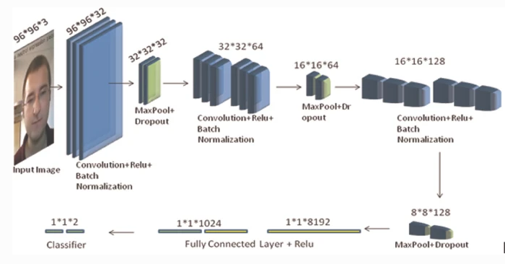
*Architecture Used In The Paper

Slide 3
*Dataset Details
-Name of the dataset used: Gender Classification Dataset
-The link of dataset: Gender Classification Dataset | Kaggle
-The total number of samples in the dataset: 3 samples (train ,valid ,test )
-Dimension of images (96 , 96)
-Number of classes & their labels : 2classes
-with labels (female , male)

Slide 4
*Implementation Details
Import the libraries
Data generation
Load the dataset
Image preprocessing
Build the model using CNN algorithm
Train the model

Slide 5
*Implementation Details Con.
7) Test the model
8) Do the predictions on the model
9) Evaluate the model
10) Visualize the evaluation of the model using
- Accuracy curve & loss curve
- Confusion matrix & classification report

Slide 6
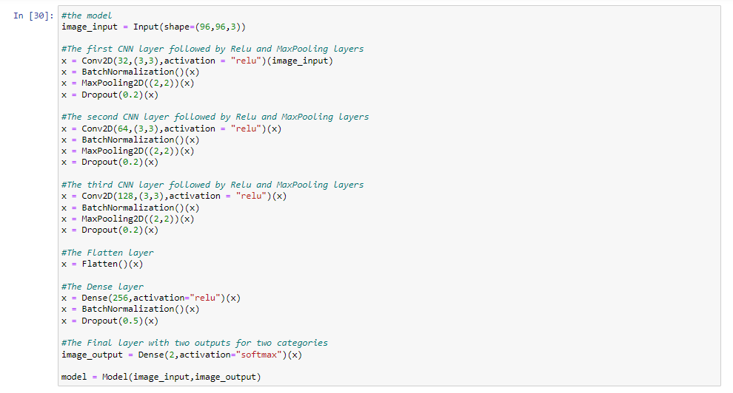
*Implementation Details Con.

Slide 7
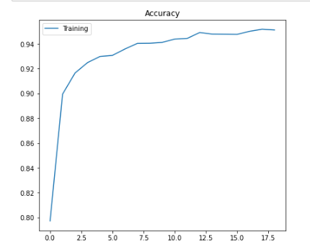
*The Results & Visualization
Accuracy is : 96%

Slide 8
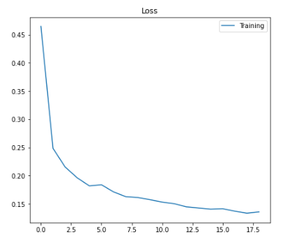
*The Results & Visualization
Loss is : 4%

Slide 9
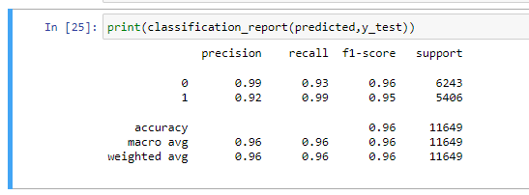
* The Classification Report

Slide 10
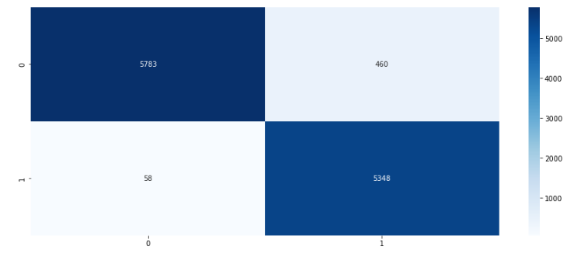
*The confusion matrix

